Slide 1
Introduction to Power point
Class -5

Slide 2

Computer system
The system that is capable of taking input process them and create a set of output.
input
process
output

Slide 3
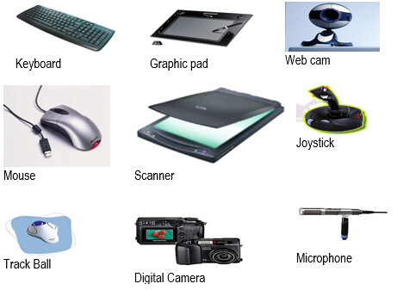
Input Devices
The raw data and information entered into the computer.
The devices that is used to give input to the computer is called input device.

Slide 4
Function of input device
Accept data and instruction
Convert these into computer understandable form
Supply the data to processing unit

Slide 5
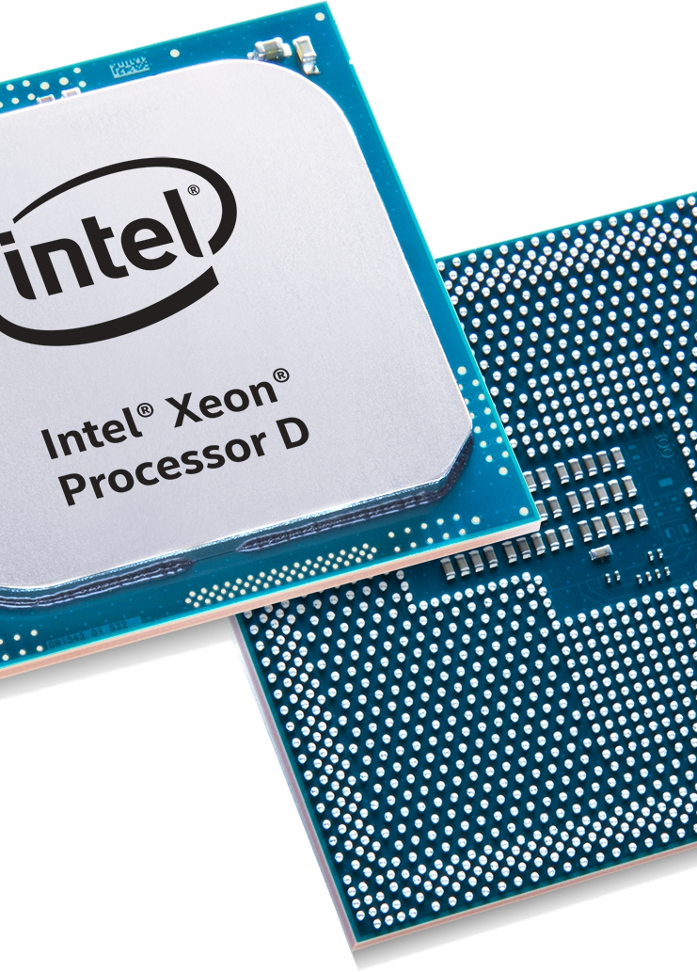
Processing device
CPU is the processing unit of the computer
All the processing takes place in CPU
CPU is the brain of the computer

Slide 6
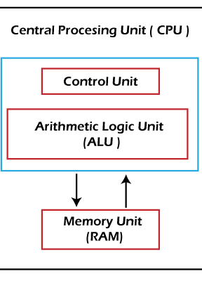
Parts of cpu
It can be divided into three parts
ALU CU and MU

Slide 7
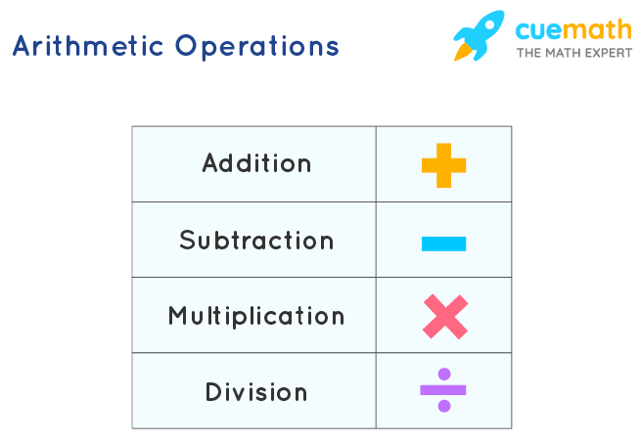
ALU
It stands for Arithmetic Logic Unit
It performs all the arithmetic calculations like addition, subtraction, multiplication and division.
It also makes comparisons of data, less than , greater than and equal to

Slide 8
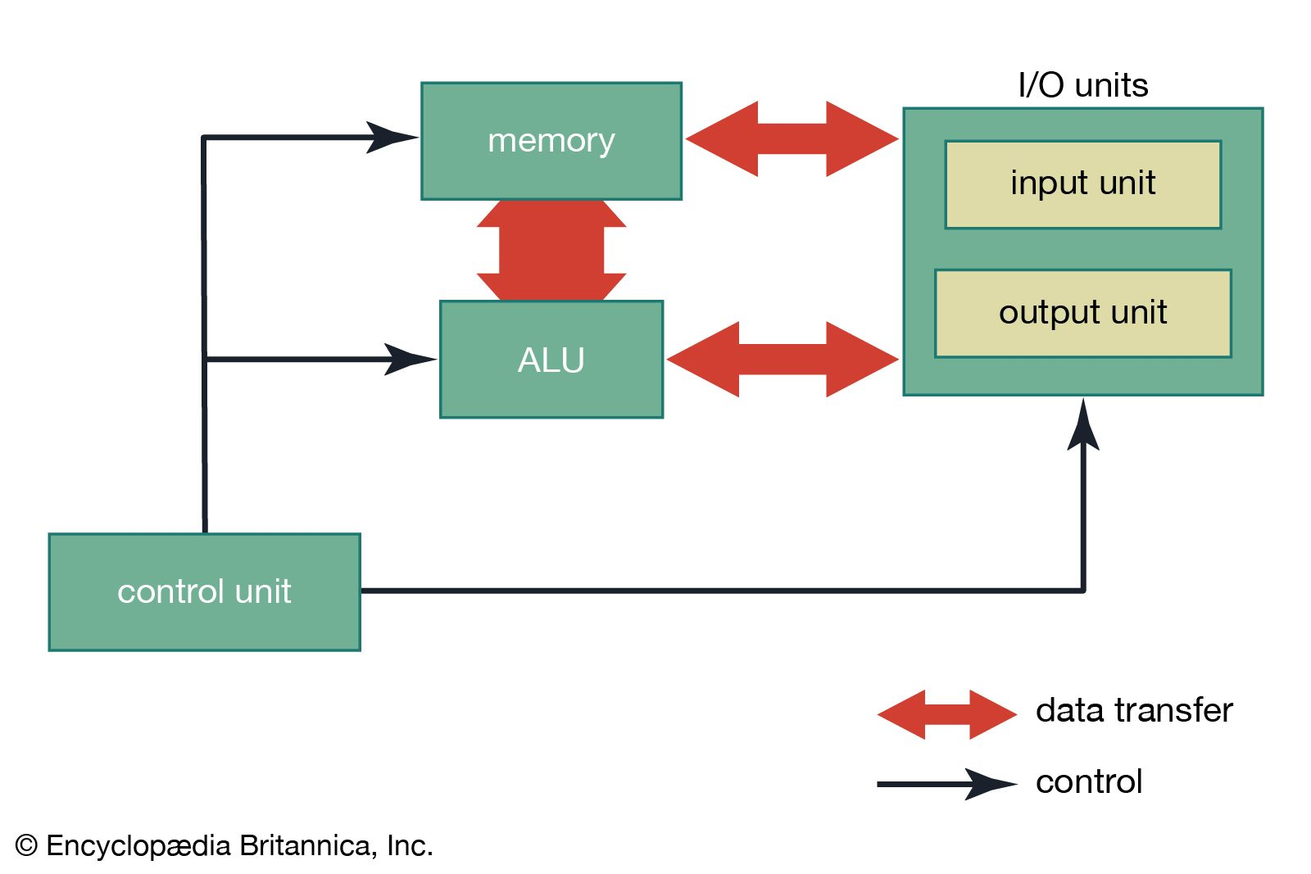
cu
It is the heart of the computer
It controls the communications and co-ordinates between input/output
It reads and interprets instructions and determines the sequence for processing the data

